Slide 1
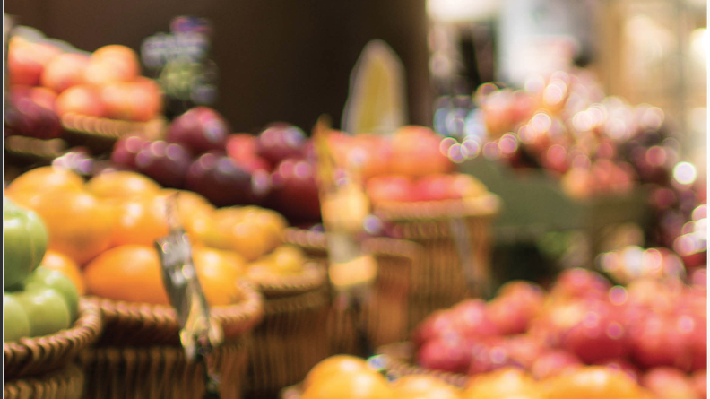
Grocery Sales Market
Ingredients for life

Slide 2
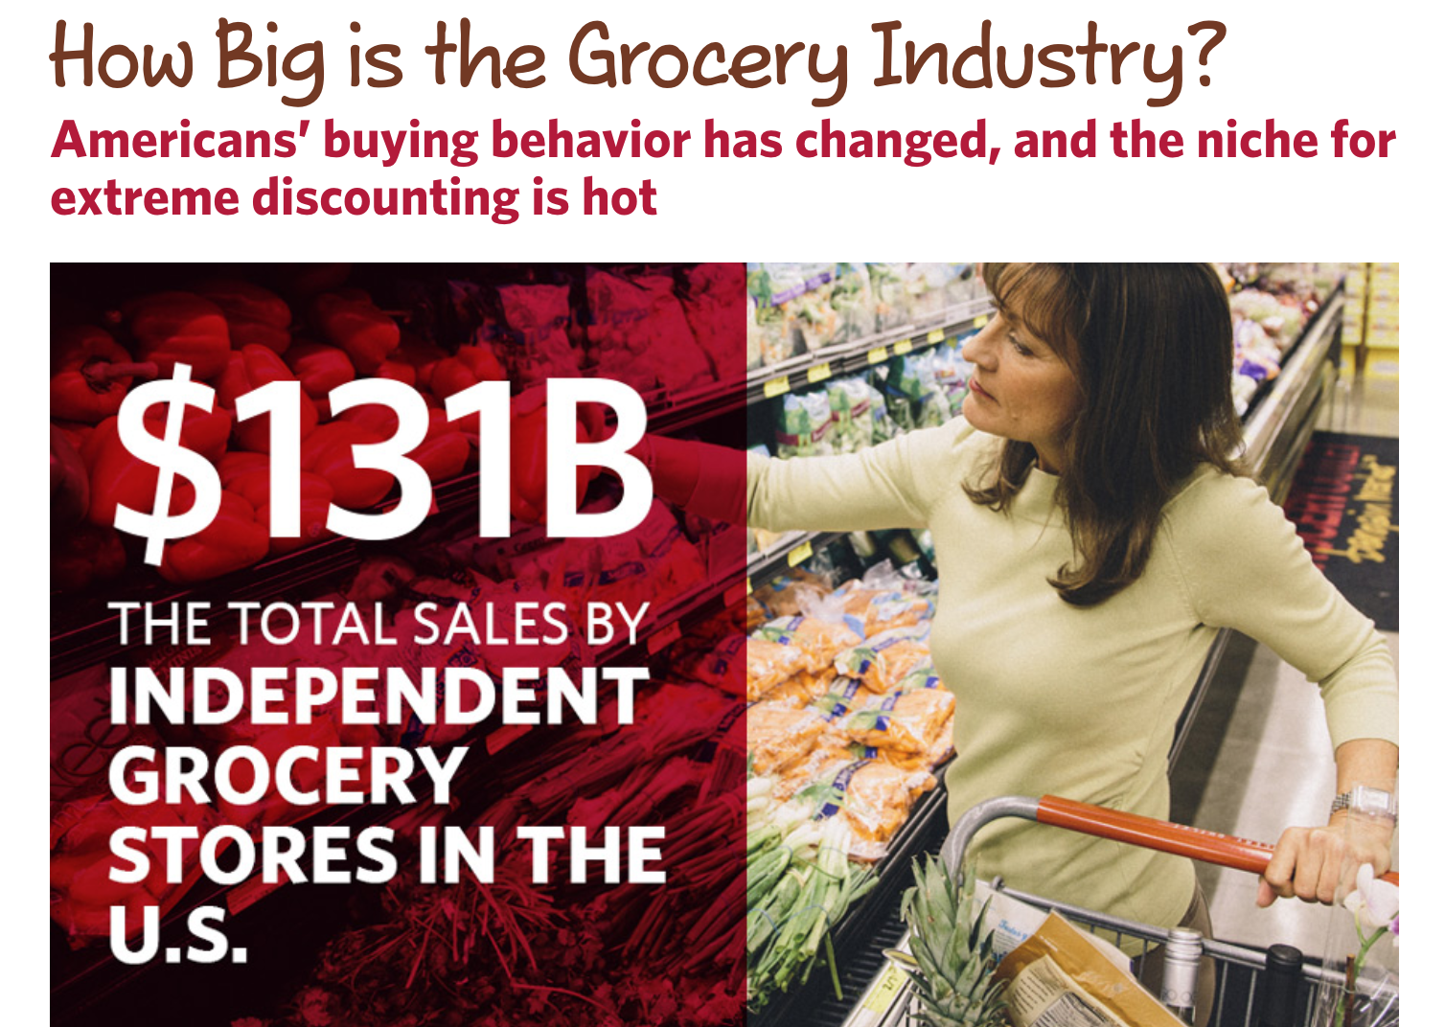

Slide 3
Presentation Outline
Common Allergic and Non-Allergic Products among different categories.
Number of Customers per city Distribution

Slide 4

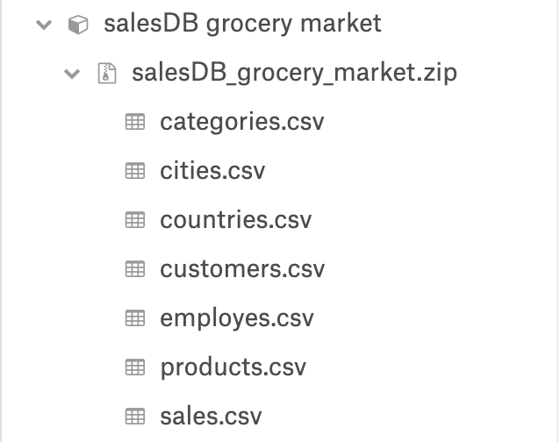
Data Sources

Slide 5
Allergic and Non-Allergic Products

Slide 6
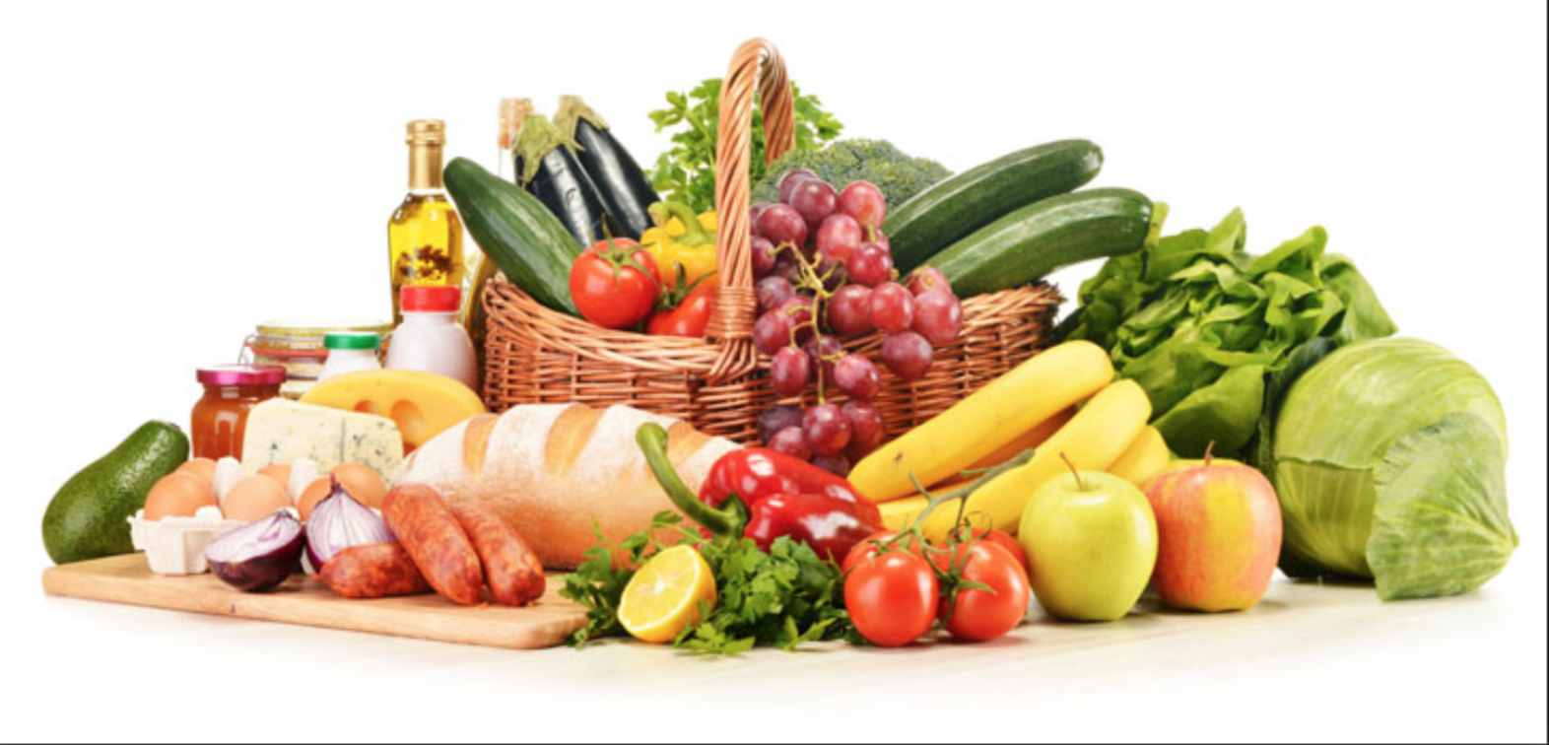
What Products Make Up This Industry ?
Confections
Shell fish
Cereals
Dairy
Beverages
Seafood
Meat
Grain
Poultry
Snails
Produce

Slide 7

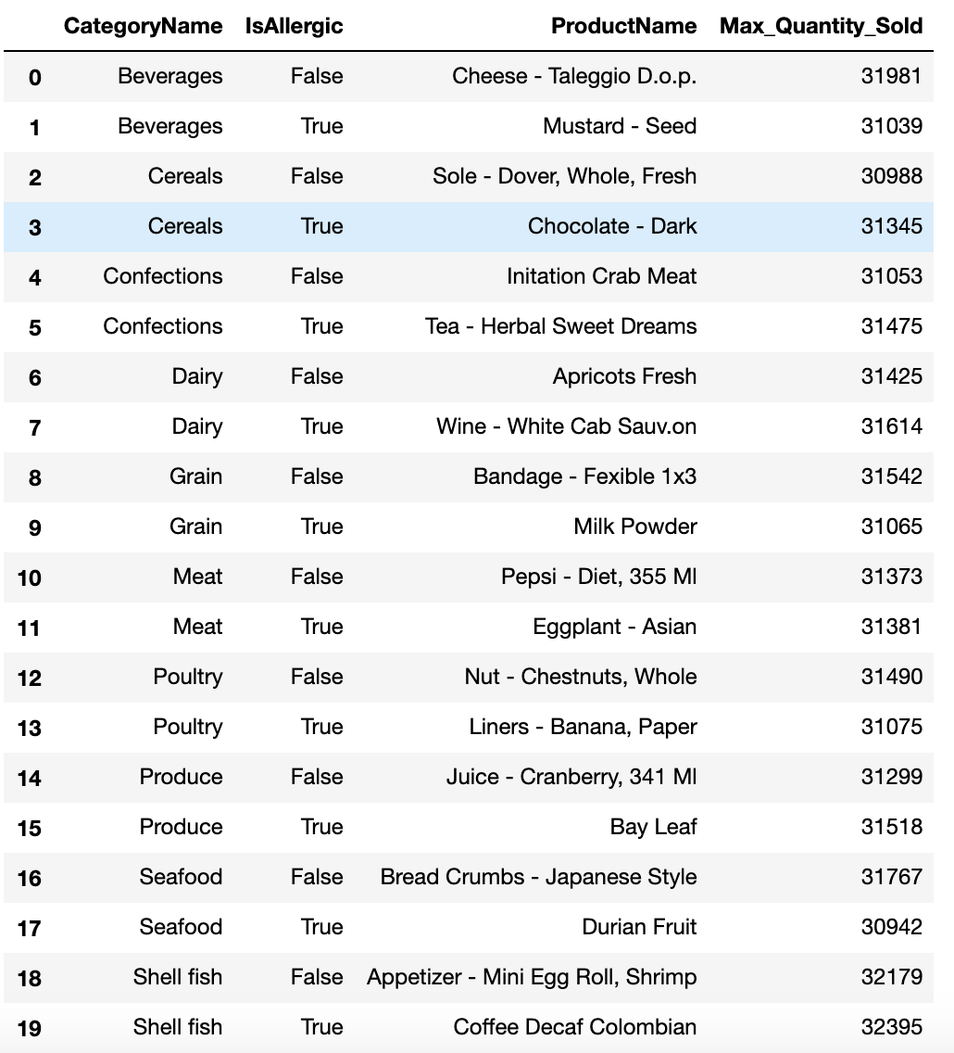



Common allergic & non-allergic products among different categories

Slide 8
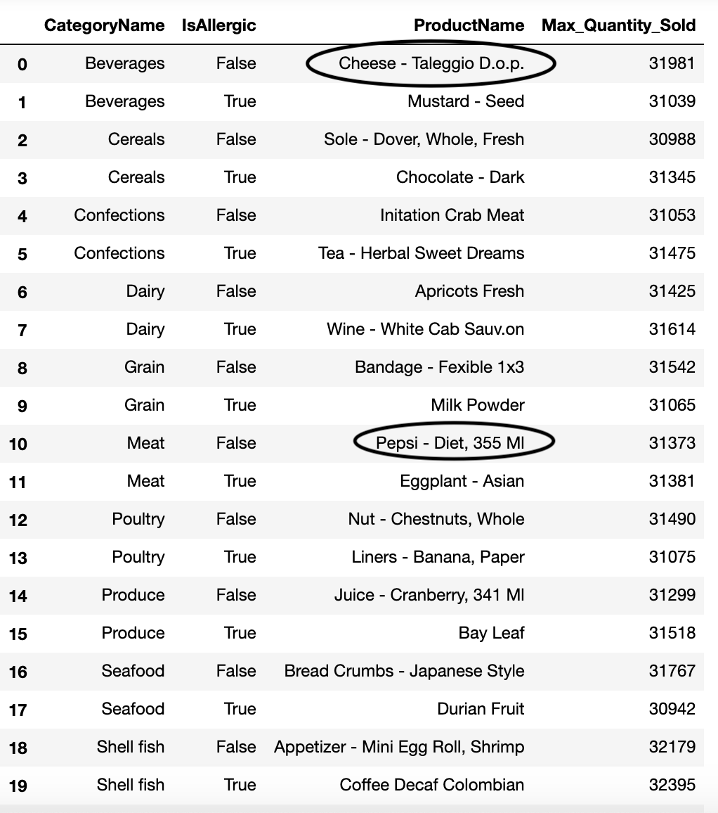
Common allergic & non-allergic products among different categories

Slide 9
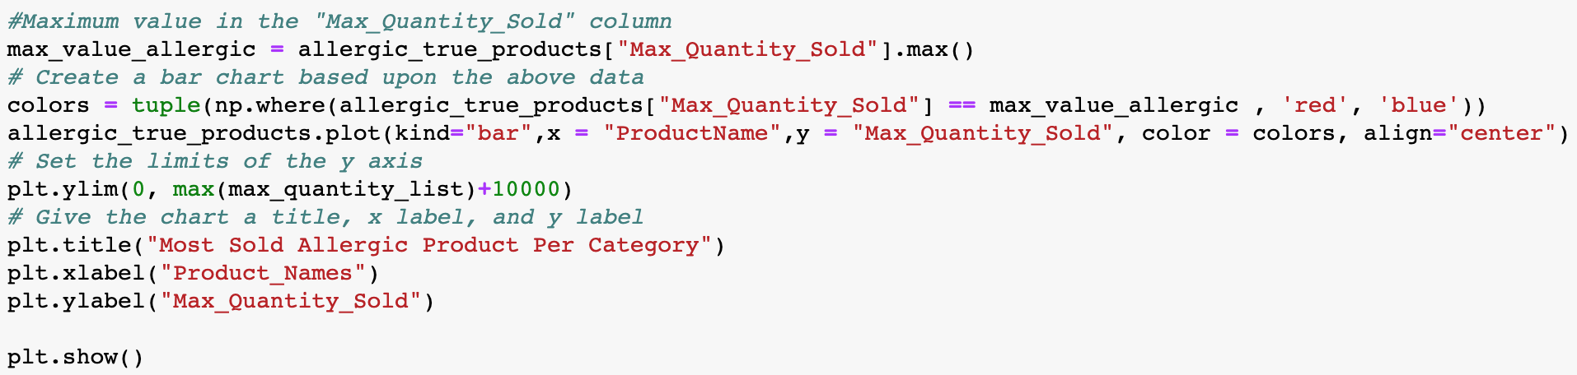
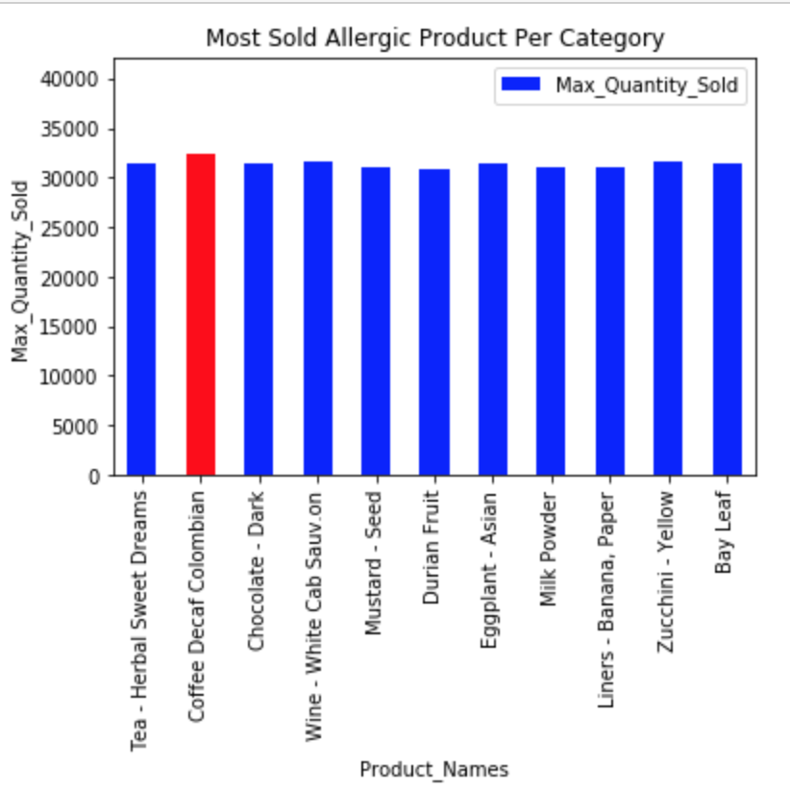
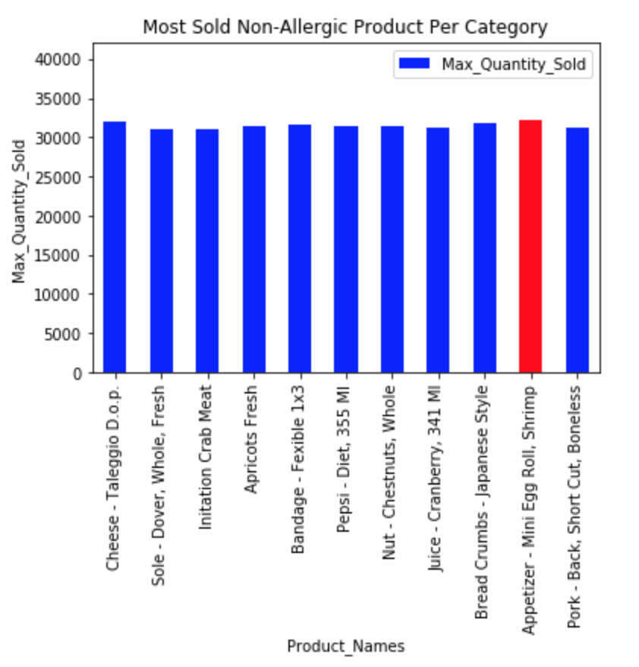
Allergic Products: 32395 quantity of Coffee Decaf Colombian is been sold.
Non-Allergic Products: 32179 quantity of Appetizer-Mini Egg Roll, Shrimp is been sold.

Slide 10
Customers vs Cities

Slide 11
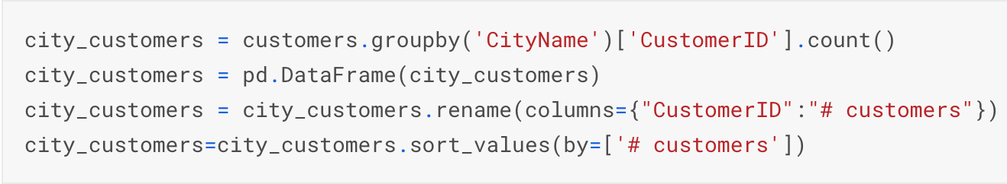
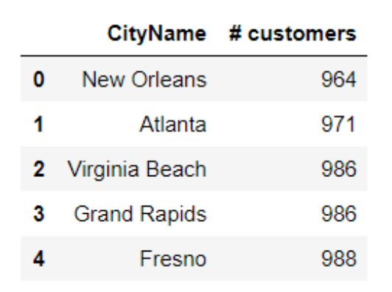
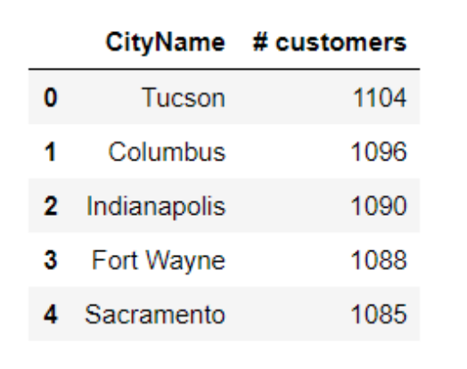
5 Cities with most customers
5 Cities with least customers

Slide 12
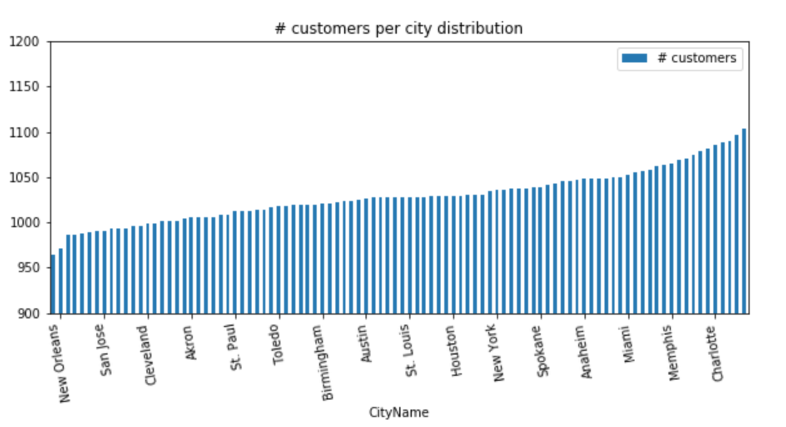
Number of customers per city distribution

Slide 13
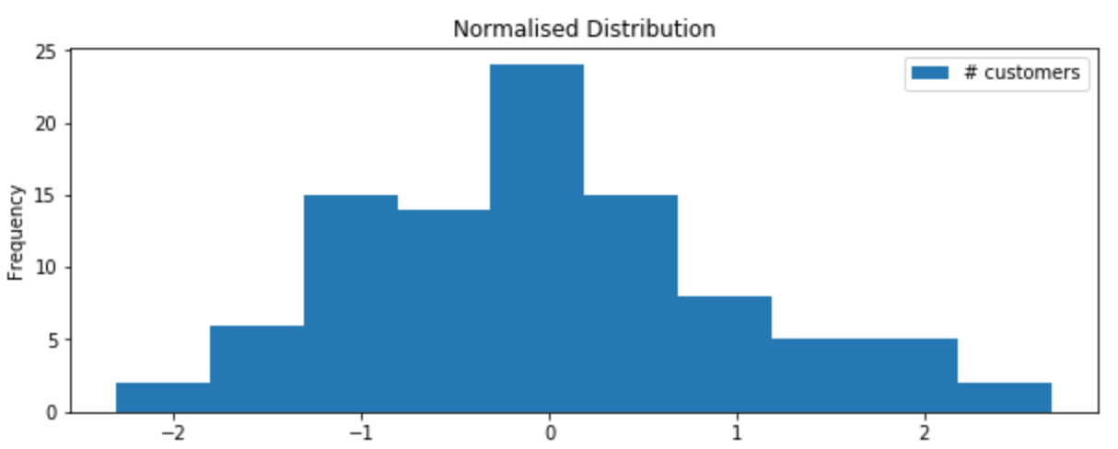
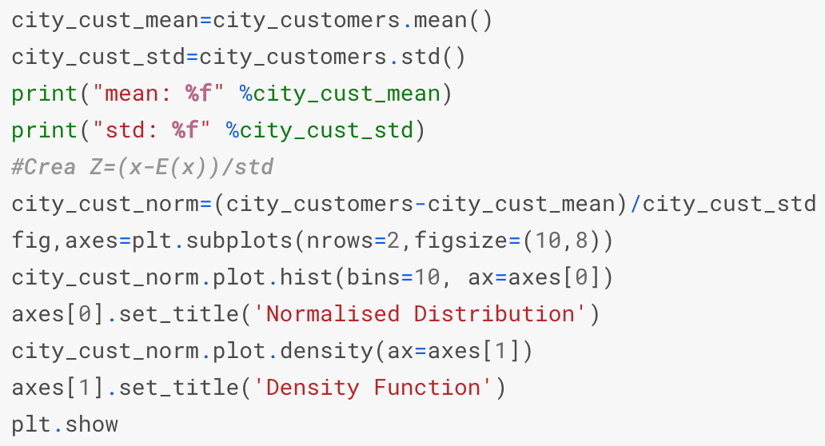
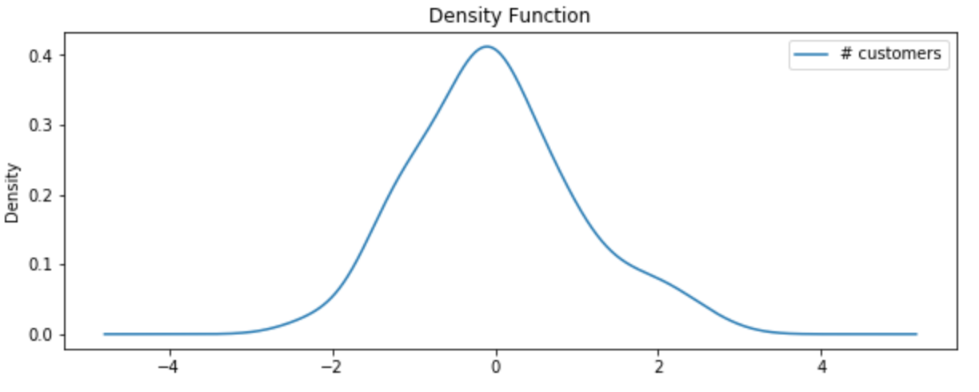
Normal Distribution of Customers
Density Function of Customers

